Slide 1

Is Technology a Double-Edged Sword?

Slide 2
Technology
Aspect
Result
As technology has advanced, it is more powerful and productive.
Technology has become more user dependent.
The use of technology has become more prevalent over time.
We are all more dependent on technology as it advances.
Many new technologies do not provide user training.
Technology is a powerful tool that can be used for nefarious ends.
More advanced applications are usually harder to learn.
Users need to master the technology they use.
Either people learn the new technology, or they are at a major disadvantage.
We don’t have the option of not learning advanced technology.
We need to learn new technology quickly on our own.
Users must be sophisticated enough to evaluate data and information.

Slide 3

Knowledge Workers

Slide 4
Drucker (1966) Defines Six Factors for Knowledge Worker Productivity:
Knowledge worker productivity demands that we ask the question: "What is the task?“
It demands that we impose the responsibility for their productivity on the individual knowledge workers themselves. Knowledge workers have to manage themselves.
Continuing innovation has to be part of the work, the task and the responsibility of knowledge workers.
Knowledge work requires continuous learning on the part of the knowledge worker, but equally continuous teaching on the part of the knowledge worker.
Productivity of the knowledge worker is not — at least not primarily — a matter of the quantity of output. Quality is at least as important.
Finally, knowledge worker productivity requires that the knowledge worker is both seen and treated as an "asset" rather than a "cost." It requires that knowledge workers want to work for the organization in preference to all other opportunities.
Source: https://en.wikipedia.org/wiki/Knowledge_worker

Slide 5
Qualities of Knowledge Workers
Possession of individual knowledge
Application of knowledge
Situations need to be novel and complex
Collective knowledge and social networks
Output of knowledge is difficult to judge

Slide 6
Knowledge Work Jobs Increasing
“The most valuable asset of a 21st-century institution, whether business or non-business, will be its knowledge workers and their productivity.“ – Peter Drucker
Knowledge workers earn approximately $50,000 a year more than non-knowledge workers, based on data from Glassdoor, one of the fastest growing jobs and recruiting web sites.

Slide 7
Tools of Knowledge Workers
They are often technical and fast changing
They must be flexible
Must adapt to their environment and situations
Liberal Arts approach to life and work
The entry level tool is Microsoft Office
https://www.youtube.com/watch?v=KmuP8gsgWb8
Bicycle for the mind

Slide 8
Analytical Skills
Critical Thinking Skills
Research and Information Analysis
Communication
Problem Solving
Source: Indeed Career Guide, https://www.indeed.com/career-advice/resumes-cover-letters/analytical-skills

Slide 9
Good Analytical Skills
Analyzing abilities: The ability to take a large volumes of data and then analyze trends and produce a result
Dealing with problems: Give examples of problem solving at work
Programming: Write a systems program with accurate results output
Reporting: A written report on the effectiveness of a particular event such as a political campaign
Handling assignments effectively: Discovering a more efficient and productive way to complete a particular job task.
Process: Creating a set of steps to implement a process that could have a yes or no outcome.
Problem handler: Identifying a problem and then creating a repair to avoid it becoming a major problem.
Collect information, analyze the data from the information collected, and come up with a solution to a problem.
Source: Job Interview Site, https://www.job-interview-site.com/analytical-skills-example-what-are-analytical-skills-and-how-to-improve-them.html

Slide 10
Association for Institutional Research
In the last few years, the Association for Institutional Research developed a paper on the direction of the institutional research function. It provided a list of duties and functions of institutional research.
Source: https://www.airweb.org/docs/default-source/documents-for-pages/duties-and-functions-summary.pdf?sfvrsn=528d0d3e_0&sfvrsn=528d0d3e_0

Slide 11
1. Identify information needs
This functional area reflects the iterative process of identifying relevant stakeholders and their decision support needs. It includes anticipating questions through review of data, information, and research and policy studies, including those related to institutional, state, national, and international conversations around higher education. It also includes assisting stakeholders in developing and refining research questions.

Slide 12
2. Collect, analyze, interpret, and report data and information
This functional area reflects the technical tasks employed by institutional research to provide data, information, and analysis for decision support. It involves an understanding of the data available to answer pressing questions about student access and success and institutional operations and the process by which previously unavailable data are collected. The process of collecting and reporting required and requested data is encompassed in this area. This function also incorporates applied research methods to analyze data to provide information for decision making, including appropriate interpretation of analysis results.

Slide 13
3. Plan and Evaluate
Planning may include operational, budgetary, and strategic planning in which institutional research collaborates with other units at the institution, state, or related organizations. It may also include program review, particularly for accreditation purposes. Formative and summative evaluation processes conducted at an institution use IR data and analysis for planning and decision-making purposes.

Slide 14
4. Serve as Stewards of Data and Information
This functional area highlights institutional research’s role in ensuring an institution-wide data strategy. Compliance issues such as privacy and security and ethical issues such as determining what data and information should be used for various purposes, and whether interpretations are correct and appropriately used, are also critical to this area. This area also includes the contribution of IR to data quality assurance activities. IR’s role in ensuring data are appropriately accessible and usable to those who need them to make decisions is inherent in this function as well.

Slide 15
5. Educate Information Producers, Users, and Consumers
This functional area encompasses the training and coaching related to the use of data, analysis, and information to inform decision making. Education can be focused on ensuring the ability to collect, access, analyze, and interpret information independently and in collaboration with other stakeholders. The function also includes a collaborative role in convening discussions related to information needs and connecting internal and external producers and users of data with one another for purposes of informing decision making. Scholarship to inform and improve data, information, and analysis for decision support is also included in this function

Slide 16
INC, September 21, 2021
Knowledge workers must have the right data, insights, and tools to make high-quality, agile decisions on their own that benefit the team. This takes trust on the part of leadership by putting the power in the hands of their workers.
That's why, even in the most efficiency-driven organizations, leaders need to give teams freedom and autonomy in calm times, to do what they do best. They need to practice innovating and coordinating without the manager in the middle.
In the end, the strength in good leaders comes from pushing authority down for others to make decisions on their own.
Good leaders understand that they don't have all the answers and that every person has something to contribute. It's a shift from the command-and-control, "chain of command" communication patterns that Musk mentioned earlier, to one where leaders and managers are relinquishing control so that individual contributors closest to the action are being empowered to act on their own.

Slide 17
Eastern Students Create Website to Help Navigate VAMS – NBC Connecticut
Watch and read how Eastern BIS students are using their skills to help fight the pandemic. https://nam04.safelinks.protection.outlook.com/?url=https%3A%2F%2Fwww.nbcconnecticut.com
%2Fnews%2Fcoronavirus%2Fcovid-vaccine%2Fecsu-students-create-website-to-help-navigate-vams%
2F2420960%2F&amp;data=04%7C01%7Chemenwayd%40easternct.edu
%7Cafd5c0f33103444068ae08d8cf4ca487%
7C00bc4ae8576c45e3949d4f129d8b670a%7C1%7C0%7C637487275892826847%7CUnknown%
7CTWFpbGZsb3d8eyJWIjoiMC4wLjAwMDAiLCJQIjoiV2luMzIiLCJBTiI6Ik1haWwiLCJXVCI6Mn0%3D%
7C1000&amp;sdata=GR%2BIsgiUYCSeawgKF8LZvTTNXdJ%2BLfoZwDkuxGna1HA%3D&amp;reserved=0

Slide 18
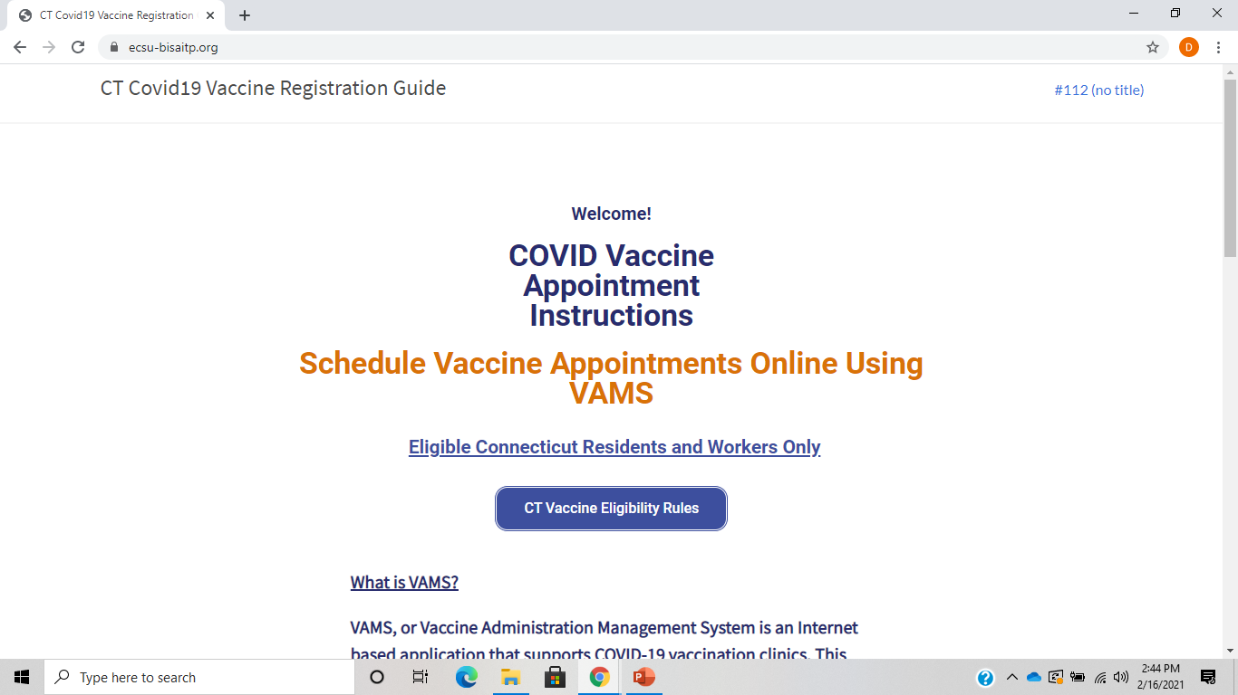
Eastern Students Create Website to Help Navigate VAMS

Slide 19
Eastern Students Create Website to Help Navigate VAMS – NBC Connecticut
Here is the website at Eastern URL:
https://ecsu-bisaitp.org/

Slide 20
Eastern’s Business Analytics Minor
The Business Analytics minor is designed to enable students to develop business data analysis capabilities and technology skills and knowledge that can be applied to a variety of organizational and decision contexts. Thus, students will be empowered to demonstrate an understanding of how data acquisition, management, analysis, and data story visualization is performed, and can be transformed into actionable insights, effective decision making, and leveraged for achieving organizational objectives.

Slide 21
Business Analytics Student Learning Outcomes:
Exhibit critical thinking skills for problem identification and data analysis approach selection.
Demonstrate proficiency with common business analytic methodologies and practices.
Acquire, combine, cleanse, manipulate, and analyze diverse datasets using a variety of tools, platforms and techniques to assist in formulating and presenting deeper insights to assist in decision making.
Apply techniques of data cleansing and processing for big data analysis.

Slide 22
Business Analytics Minor Requirements
Business Analytics Minor Requirements
Four Required Courses
BIS 205 Information Management (3 credits)
One Statistics Course (3 credits)
 |  | ECO 215 Statistics for Business & Economics
 |  | MAT 216 Statistical Data Analysis
 |  | PSY 227 Behavioral Science Statistics
 |  | SOC 351 Statistics for Social Research
BIS 373 Business Database Management (3 credits)
BIS/BUS 305 Business Analytics (3 credits)
 | One or both of the Following Two Courses: (3 credits)
 |  | BIS 447 Business Intelligence
 |  | BIS 449 Data Visualization
 | One or more of the following courses: (3 credits)
 |  | BUS/FIN 346 Investment Analysis
 |  | BUS 360 Supply Chain Management
 |  | BUS 363 Six Sigma & Continuous Improvement
 |  | BUS 380 Quality Improvement in Healthcare
 |  | BUS 428 Marketing Research
 |  | BUS 433 Strategic Talent Management
 |  | ECO 305 Econometrics
 |  |  | Total credits = 18

